Slide 1

CyberSentinel: An Emergent Threat Detection System for AI Security
Presented by Aliyan Ahmed Cheema
FA22-BCE-028

Slide 2

Introduction
AI systems introduce new and unpredictable vulnerabilities.
Traditional cybersecurity tools are reactive and ineffective against emergent threats.
CyberSentinel is proposed as a unified, single-agent AI security system for real-time detection.

Slide 3

Literature Survey
Rule-based systems can't handle zero-day and AI-driven attacks.
Emergent threats like prompt injection and model drift remain undetected.
Past works rely on static rules or manual labeling – CyberSentinel uses unsupervised ML.

Slide 4

Contributions of the Paper
Unified detection of brute-force, phishing, and anomaly-based threats.
Single-agent design for low-complexity, real-time response.
Self-adapting anomaly detector using Isolation Forest and Mahalanobis Distance.

Slide 5
System Model
Security Agent orchestrates three modules:
- Brute-force SSH log analysis
- Heuristic-based phishing detection
- Emergent Threat Detector (ETD) using ML
Runs as a multi-threaded Python daemon.

Slide 6
Simulation & Results
Processed 1M SSH logs in under 3 minutes.
Handled 10,000 phishing URLs/sec.
Anomaly detection accuracy ~98%.
Retraining every 30 days prevents model drift.

Slide 7

Discussion on Results
High accuracy with low latency enables real-time security.
Unsupervised learning allows generalization to unknown threats.
Modular design simplifies deployment and updates.

Slide 8
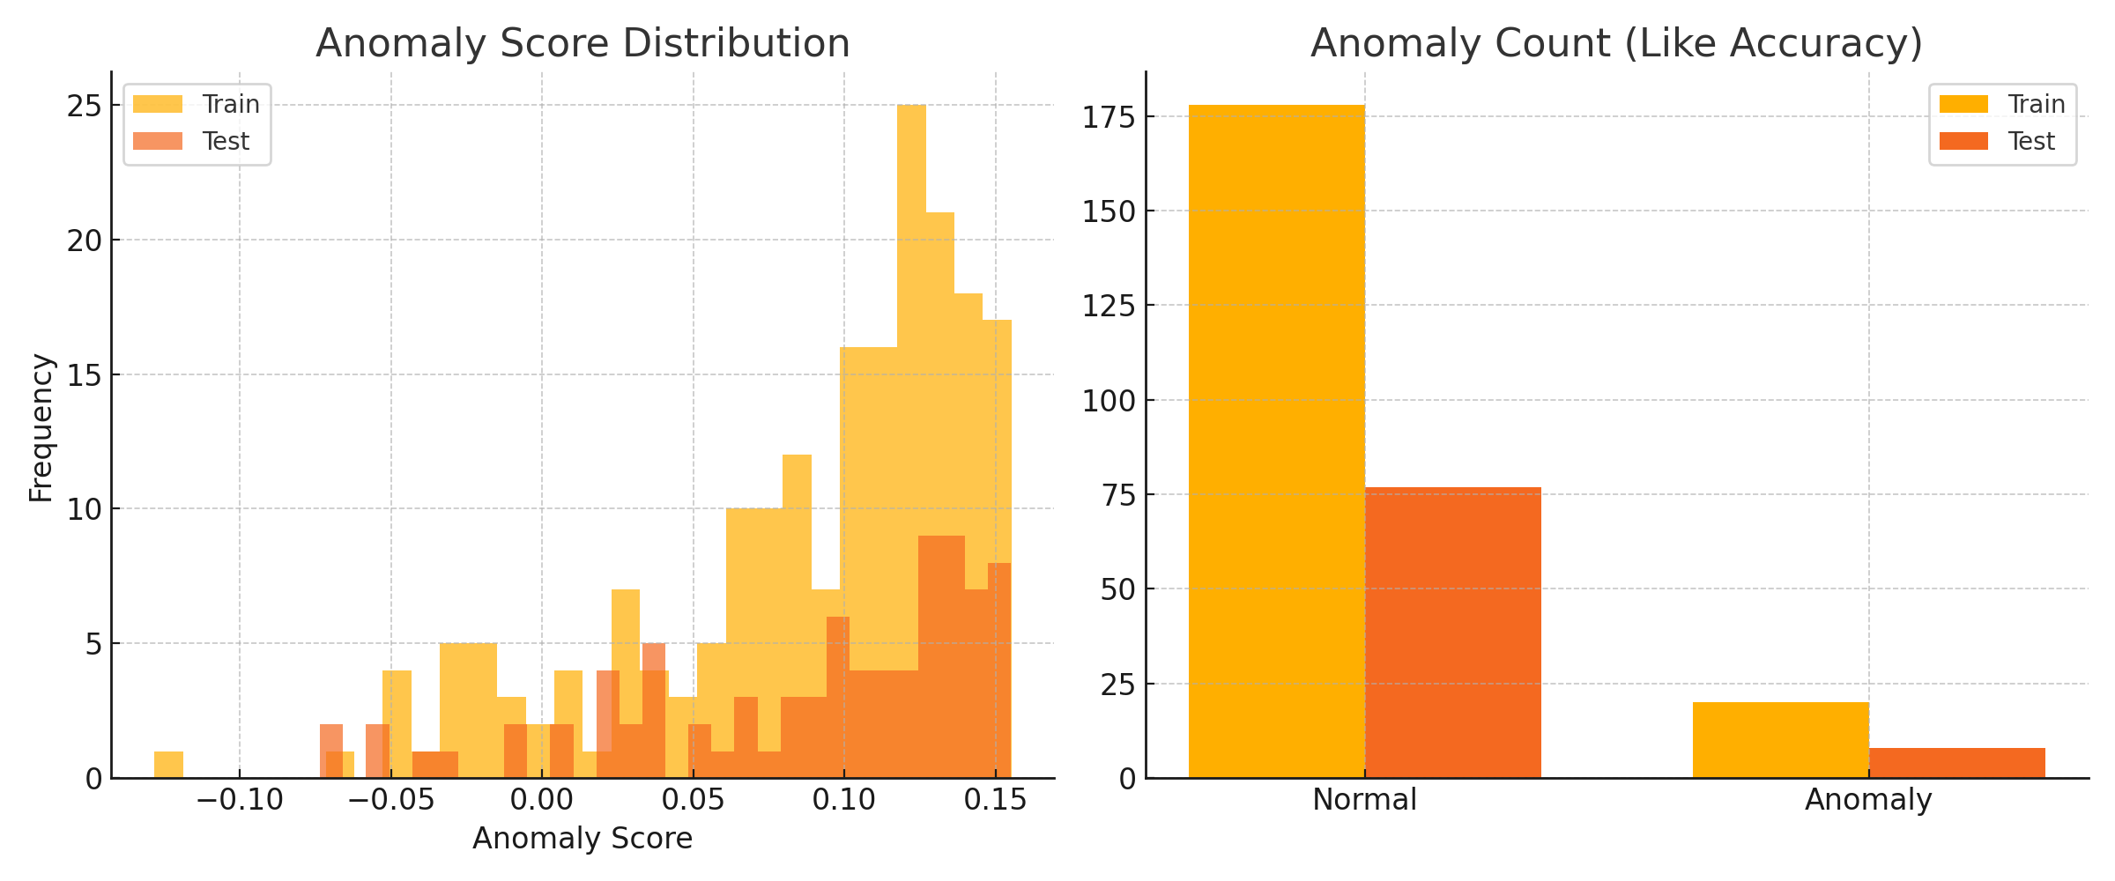
Model Results (Isolation Forest)

Slide 9

Conclusion and Future Work
CyberSentinel is an adaptive, AI-based real-time security system.
Effective against known and emergent threats.
Future directions: reduce false positives, deepfake detection, XAI integration.

